Slide 1
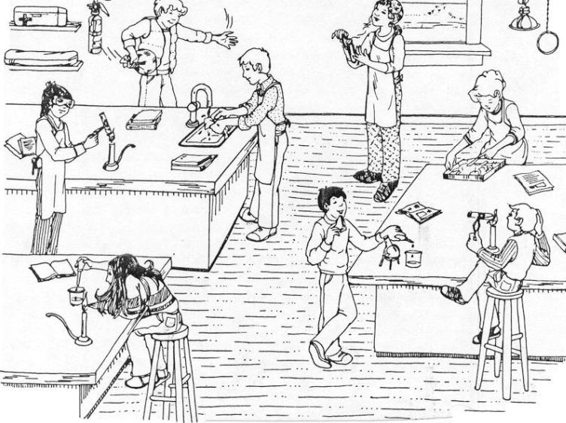
Lab Safety Review

Slide 3
What is WHMIS?
A method of ensuring everyone has access to safety information about any substance that they may encounter
There are 10 WHMIS symbols, shown below

Slide 13
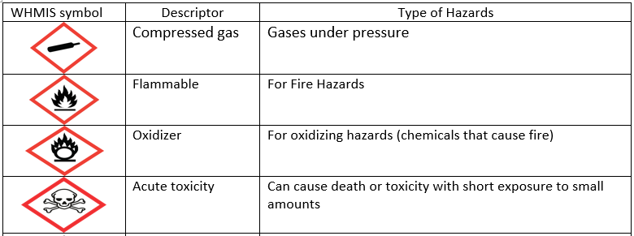

Slide 15
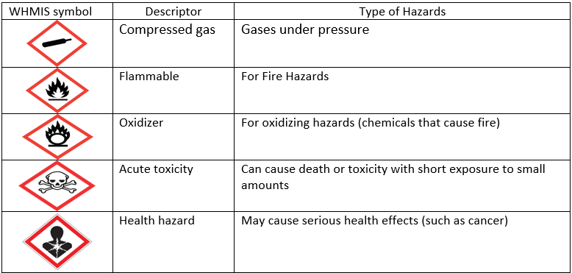

Slide 17
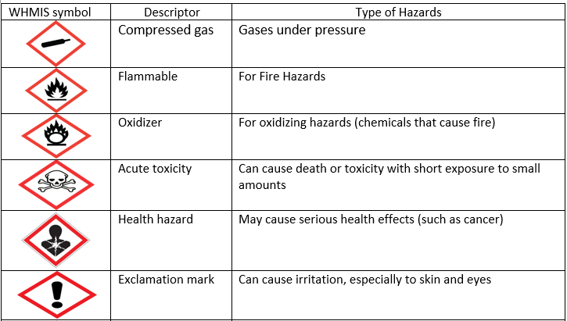

Slide 19
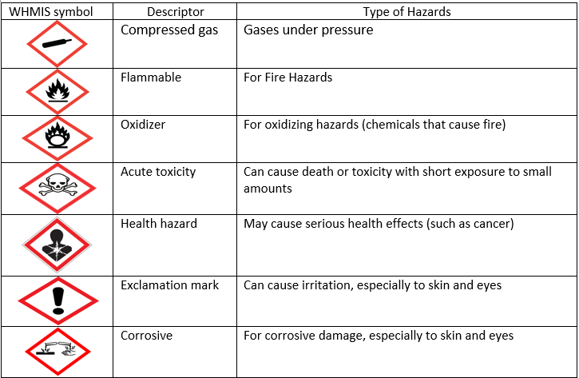

Slide 22
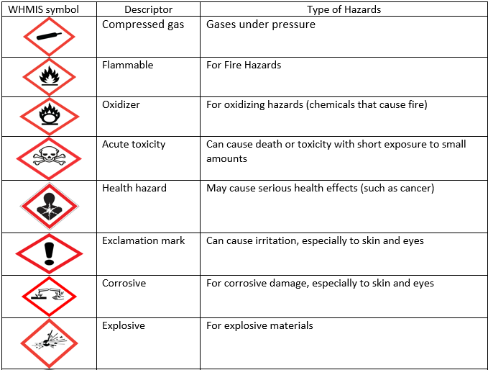

Slide 23
v

Slide 25
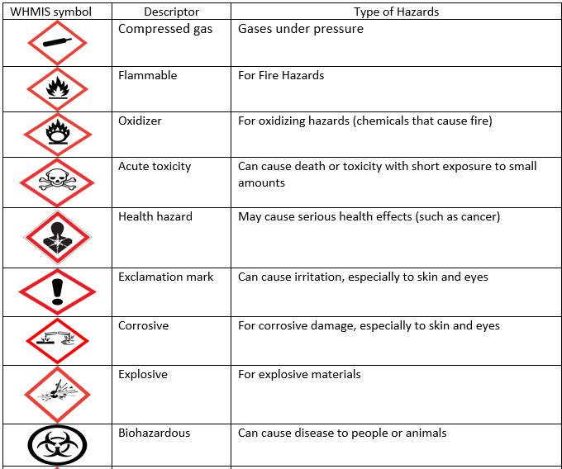

Slide 27
Environmental Hazard!! (Added to WHIMIS sheet after 2015)

Slide 28
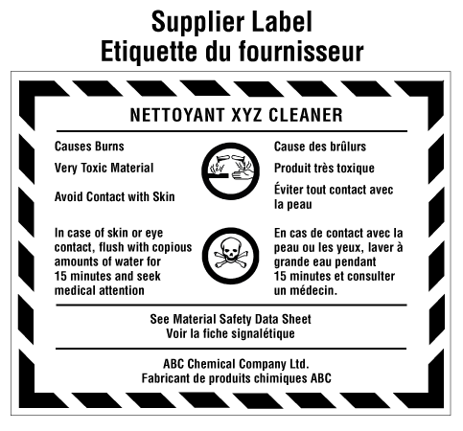

Slide 29
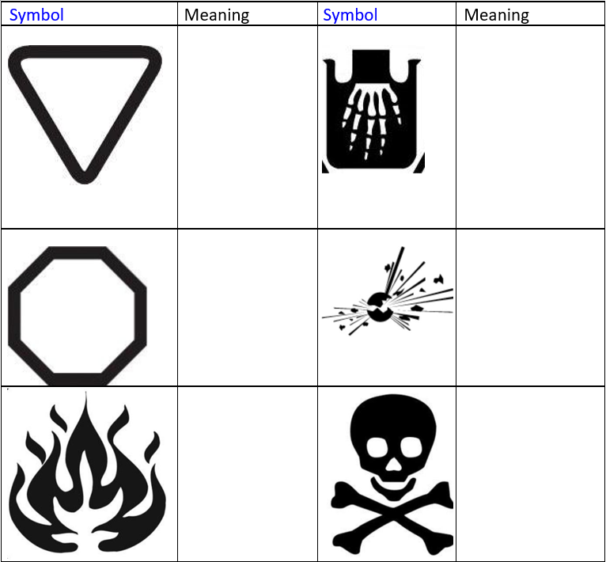
House Hold Products
Dangerous
Container –
handle
container with
care, do not
drop, etc
Corrosive – wear
gloves and
goggles,
Dangerous
Contents –
handle contents
with care
Explosive –
Handle with care,
keep away from
heat, flames, and
sparks
Flammable –
keep away from
heat, flames,
and sparks
Poisonous – wear
gloves, wash
hands, do not
breathe in, etc.

Slide 30
MSDS (Material Safety Data Sheet)

Slide 31
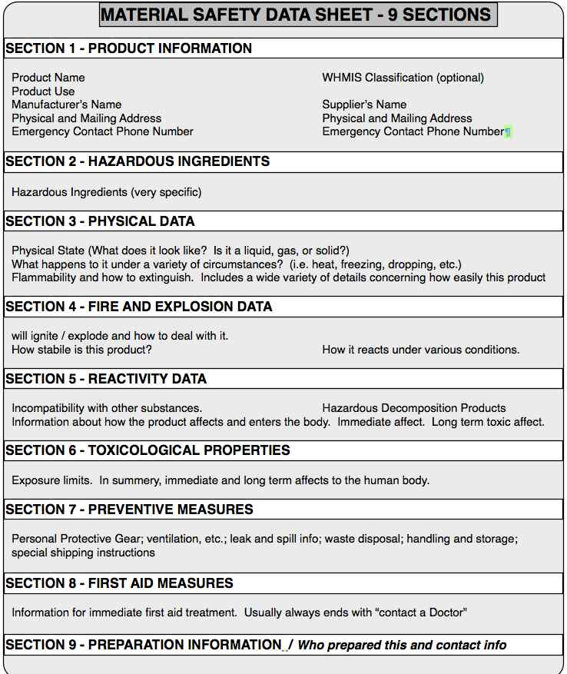

Slide 32
Plan for the day:
1) Make W.H.M.I.S and Household products flash cards:
Draw symbol on one side
Write description on other side
Due by end of class!
2) Finish work booklet (due on Monday)

